Slide 1
Contagious Diseases in the United States:
Trends and Patterns in the Past 100 Years
INFSCI 2415 Information Visualization
Group 5
Chen Song, Jiexiao He, Jingran Xie

Slide 2

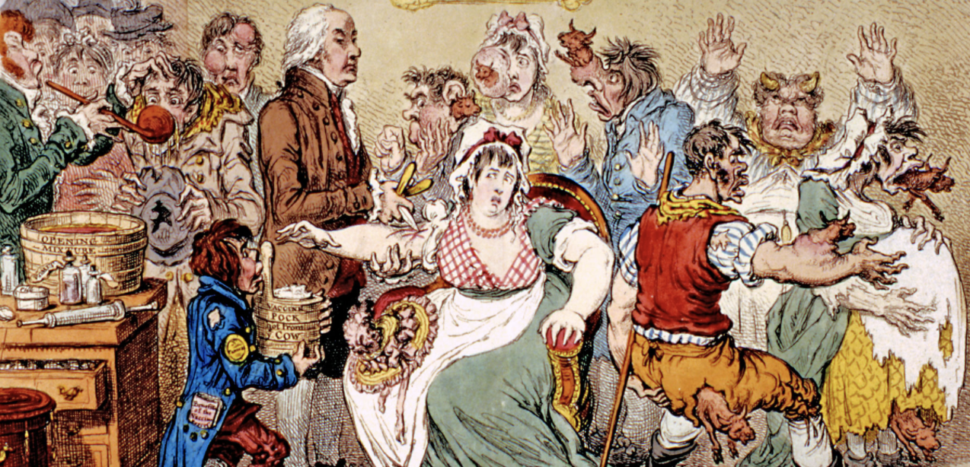
Motivation
Contagious diseases are always important issues in human history:
Black death killed 30-60% of Europe’s population during 14th century;
Smallpox was a main factor in choosing the heir to the throne during Qing Dynasty in China.
It is important to understand the trends and patterns in contagious diseases spreads and preventions.
Vaccination of Smallpox

Slide 3
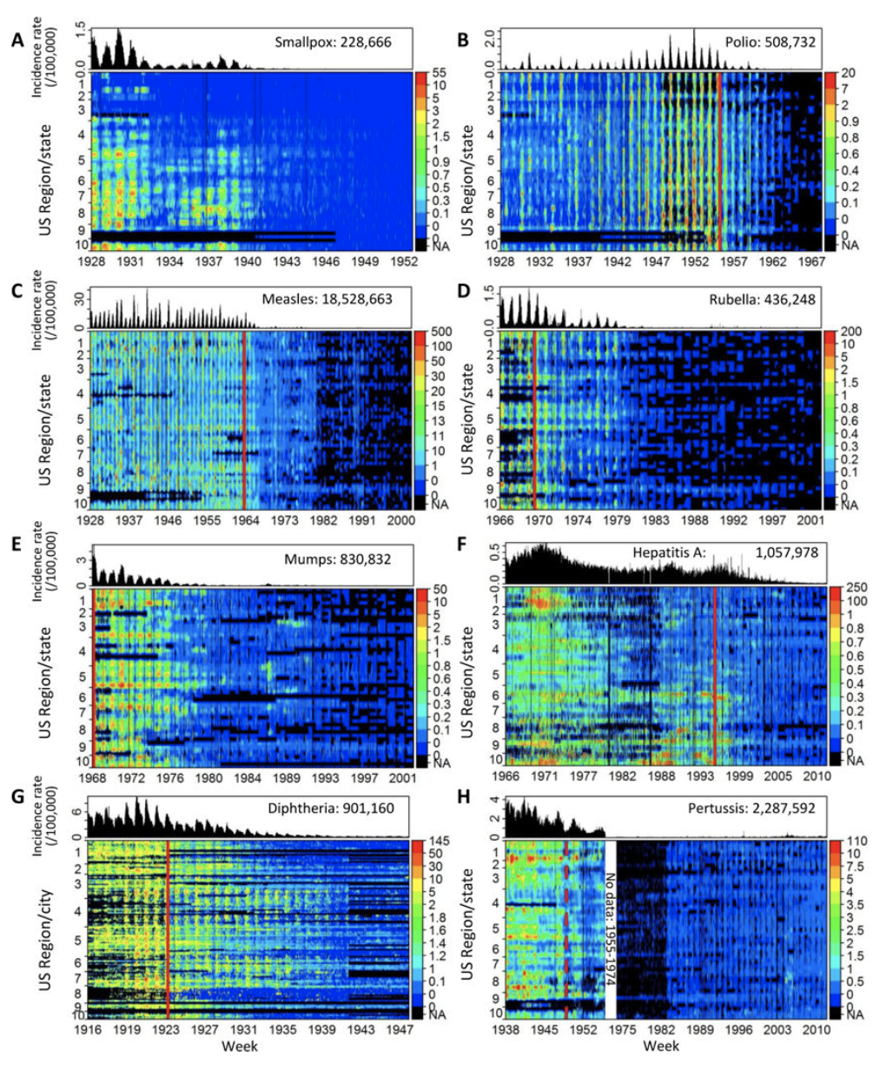
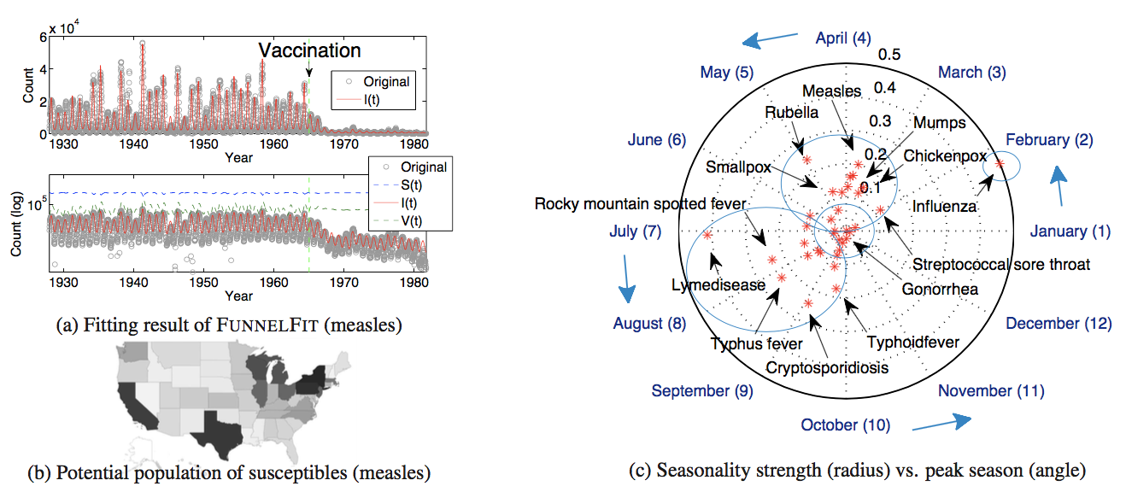
Related Work
Explored 5 properties of 56 contagious diseases: (P1) disease seasonality; (P2) disease reduction effect; (P3) local/state-level sensitivity; (P4) external shock events; (P5) detect incongruous values. (Matsubara, Yasuko, et al. 2014)
Explored the effects of vaccination: “declines in the incidence of contagious diseases in the United States over the past century. However, some contagious diseases are now on the rise despite the availability of vaccines. ” (Van Panhuis, Willem G., et al. 2013)

Slide 4

Data: Project Tycho Level 1 Data
Project Tycho contains three datasets:
Level 1 data contains different types of counts of 8 diseases in 50 states and 122 cities from 1916 to 2010 which have been standardized in a common format.
Level 2 data contains informational counts of 50 diseases in 50 states and 1284 cities from 1888 to 2014 which have been reported in a common format.
Level 3 data contains different types of counts of 58 diseases and 81 disease subcategories in 3026 cities which have not been standardized.
We use level 1 data to design and test our visualizations:
includes counts at the state level for smallpox, polio, measles, mumps, rubella, hepatitis A, and whooping cough, and at the city level for diphtheria.
7 fields: epi_week, state, loc, loc_type, disease, cases, incidence_per_100000.

Slide 5
Project Goal
Reveal Trends and Patterns in Contagious Diseases’ spread and prevention:
Trends: diseases declined over time, mainly due to vaccination, but could be also significantly affected by general economic developments, i.e. availability of public health program or clear water.
Seasonal Patterns: some diseases have peaks during warmest or coldest weather, while some other diseases may not be affected by weather.
Spatial Patterns: some places are more vulnerable to a particular disease, maybe because of the local natural environment.

Slide 6
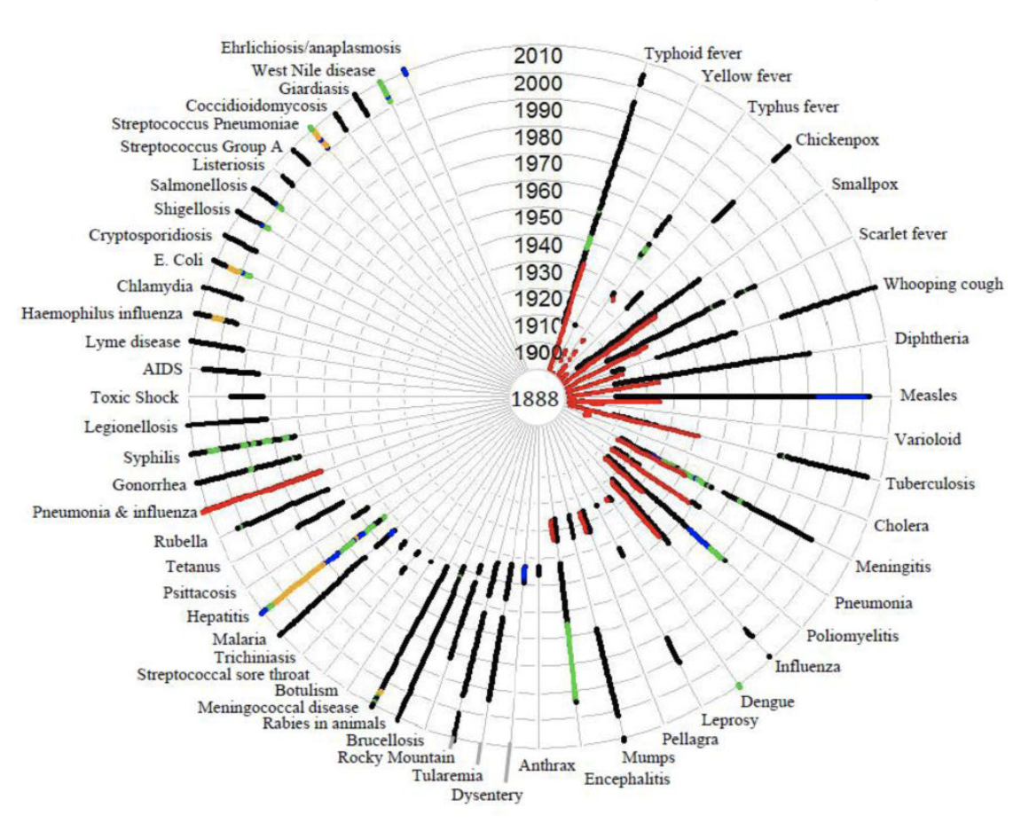
Challenges
Data availability: 1) the spatial and temporal range covers every disease is different to each other, and 2) some diseases are already disappeared in the recent years, which give us a lot of zeros in the dataset.
Scalability: the data size is relatively large (100+ years * 52 week/year * 8 diseases * 50+ states&cities = 2,000,000+ observations).
Van Panhuis, Willem G., et al. 2013

Slide 7
Data Preparation
Handle missing data
Separate and aggregate the data based on the visualization needs.
Aggregate the cities to states for the disease has city level information
Aggregate 52 weeks to a year
Aggregate 50+ states & regions to the whole country
Add GDP per capita as the economic factor that will influence the diseases.
Rebuild data into proper format

Slide 8
Visual Design Overview
Trend
Seasonal Patterns
Spatial Patterns
Best encodings for time -series relationship: lines to emphasize the overall shape of the data.
Best encodings for correlation: points and a trend line in the form of a scatter plot.
What we want to seek: seasonality -- using cyclic arrangement to find seasonal patterns.
Using map with animation to show the spatial patterns changing over time.

Slide 9
Trends in the Past 100 years: Assumptions
Disease declined due to vaccine usage: not only affected by the invention of vaccine, but also the availability of the vaccine to public;
Disease declined due to economic development: financial ability to provide public health program, clear water, etc.;
Disease explosion because of special events: economical crisis, wars or disasters

Slide 10
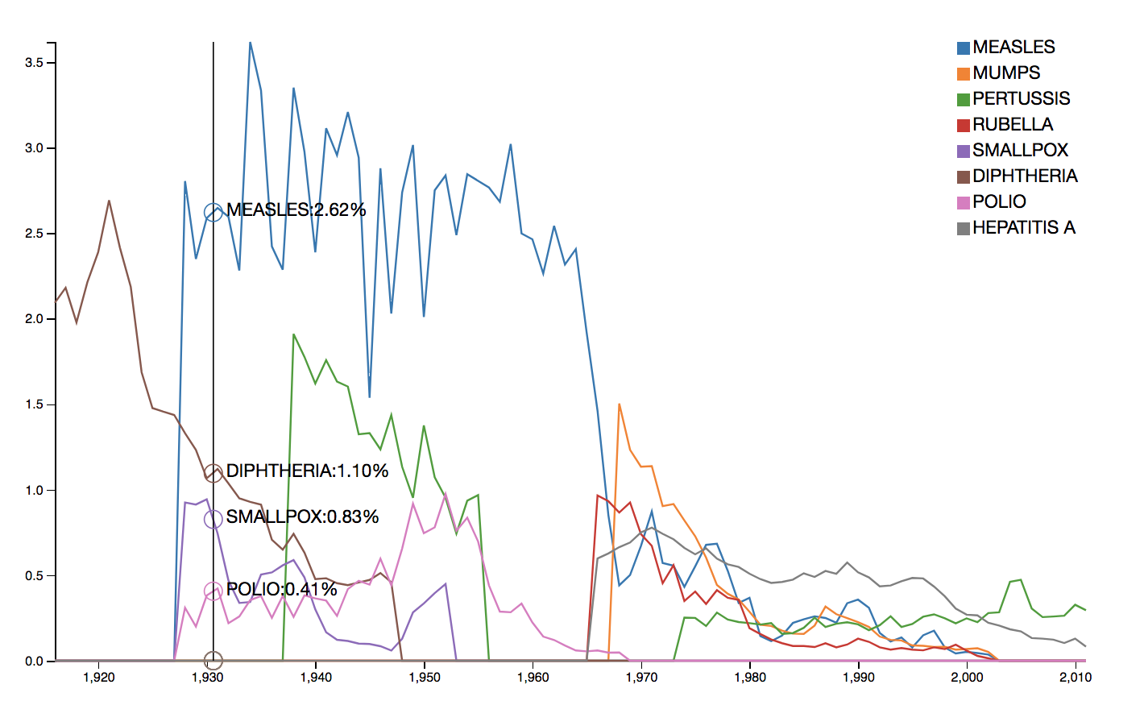
Trends in the Past 100 years
An overview of diseases decline and re-emerge
Layout: multi-line chart, each line represents a disease
Visual encoding:
X-axis: time (year)
Y-axis: incidence rate (%)
Color: category of diseases
Interaction:
Mouse over: detail number of each point

Slide 11
Discussion
Why multi-line chart
Line chart is good to show the general trend
Line chart can show disease explosion clearly
Multi-line can compare trends between different diseases
Patterns
All the diseases are in a decrease tendency in these 100 years
In 1940s and 1970s, these are two big disease explosions

Slide 12
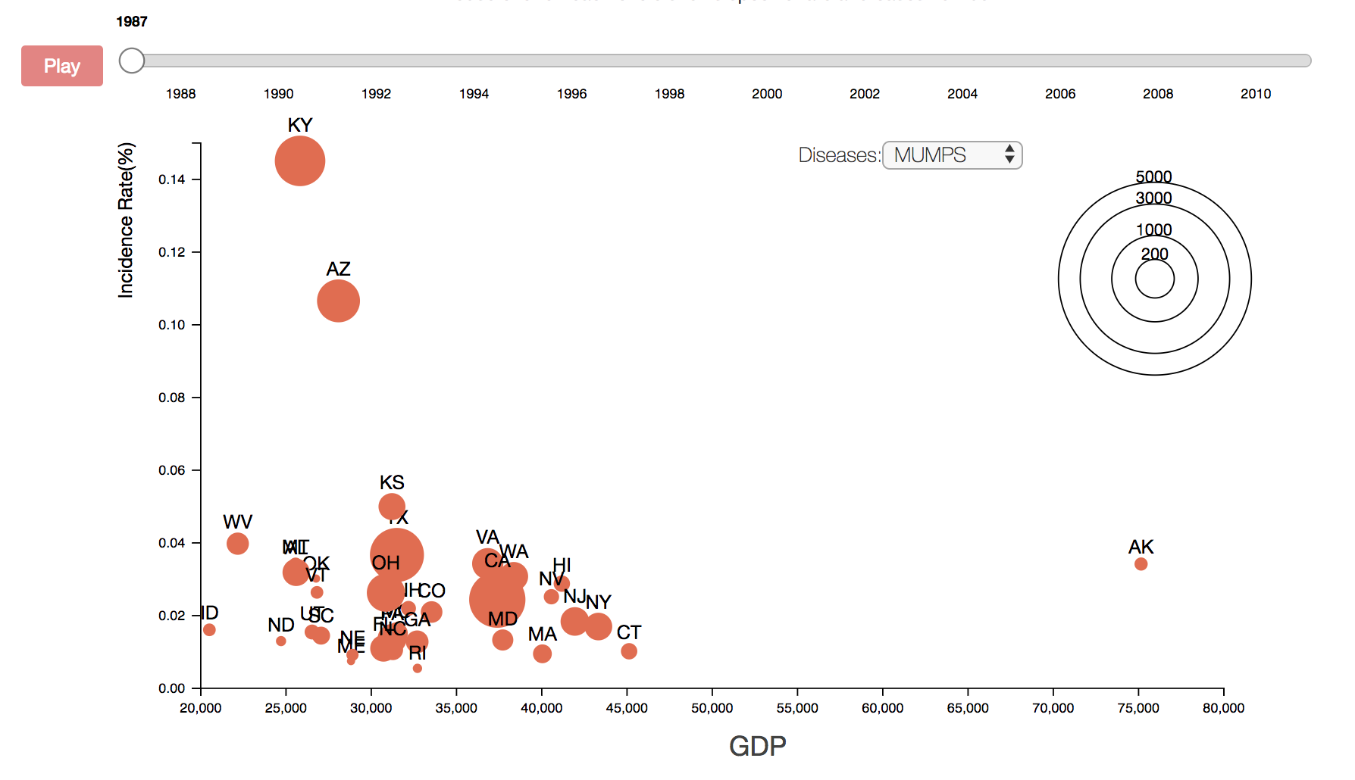
Trends in the Past 100 years
The relationship between diseases and economy
Layout: scatterplot, each scatter represent the value of a disease in a state
Visual encoding:
X-axis: GDP per capita ($)
Y-axis: incidence rate (%)
Size: cases
Text label: state name
Animation: time
Interaction:
Slider: time
Select box: category of diseases

Slide 13
Discussion
Why scatterplot
Scatterplot is a good visualization to show relationship between two features
Scatterplot can also compare difference among data nodes
Assumption
With GDP increasing, incidence rate will decrease
Result
Although there are some explosions, the rate is decreasing in general
Low GDP states are more vulnerable

Slide 14
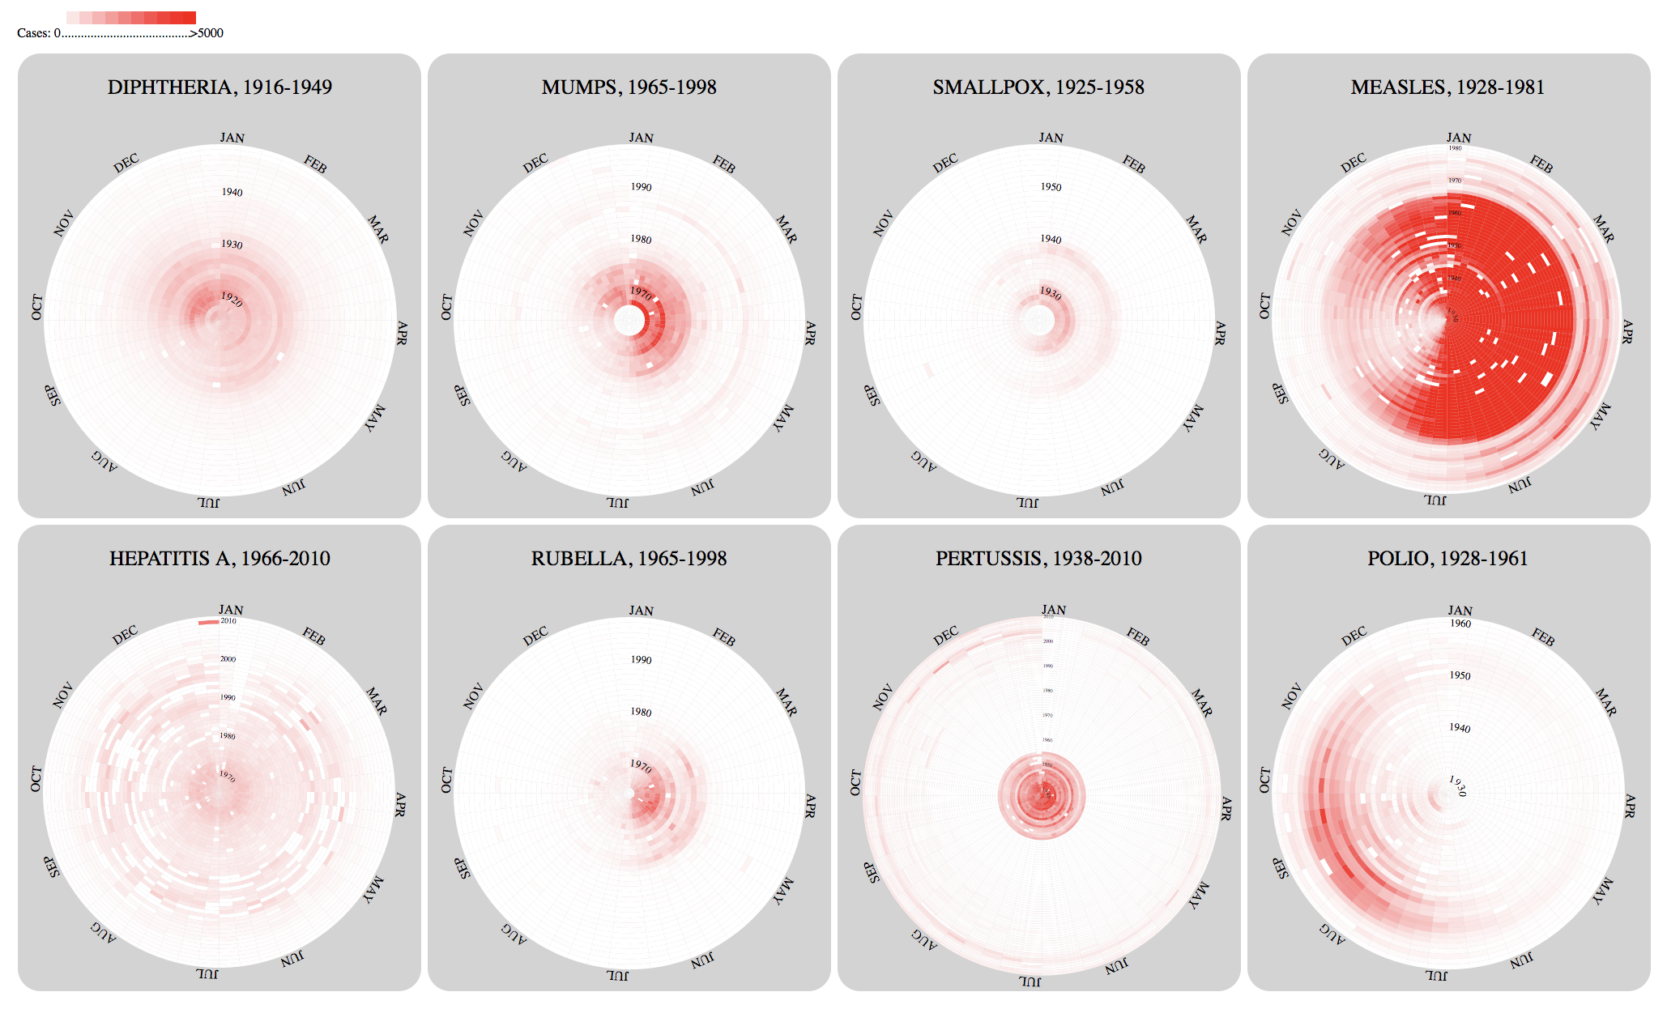
Seasonal Patterns
Layout: multiple circular heat maps
Visual encoding:
Angle: same week of each year
Radius: year
Color: cases across the States
Interaction
Click to switch between small multiples and detail individual graphs
Mouse over in detail graphs: detail information of each grid
Notes:
To analysis the seasonality of the diseases, we use 8 circular heat maps for the 8 diseases. As you can see in the figure, the angle of each circle represent 52 weeks of each year and every ring represents a year. The color of each grid represents the value of cases per disease per week. We also add some interactions on this visualization: if you click one of the circles, a bigger circle will appear to show a clearer picture of the disease and the mouse over function will show the detail information of each grid including time, cases and incidence.

Slide 15
Discussion
Why circular heat map
Heat map is one of the best way to find clusters
Advantage of circular heat map: easily to find repeated patterns even the pattern appears at the beginning or ending of each time interval
Disadvantage of circular heat map: uneven size of each grid
Why small multiples
compare across diseases
Patterns
There is no significant seasonal pattern in HEPATITIS A and PERTUSSIS
The peak of DIPHTHERIA appeared in Nov - Dec
Most cases of MUMPS and SMALLPOX appears in the first half of a year
The peak of RUBELLA appears in Apr - Jul
The peak of POLIO appears in Aug - Oct
There will be less of MEASLES during Aug - Nov
Notes:
Why we choose to use circular heat map: heat map is one of the best way to show clusters, and circular heat map could show the repeated patterns more clearly, even the pattern may appear at the beginning or ending of each round of the time, while rectangular heat map may not have good performance to show it. But on the other side, the size of each grid in circular heat map is uneven, so it may be hard to see the grids near the center.
We put the 8 circles together to compare the seasonal patterns across the 8 diseases. We can see that …
We can also see some trends in the circular heat maps about the explosions and declines of the diseases, which could reinforce our other analysis

Slide 16
Discussion
Special challenge: ranges of cases are very different across the diseases
Other visualizations mainly show the incidence of each disease
In Measles the max is over 50,000, while in other diseases the max is about 4000-7000
Use [0, 5000] as domain in color encoding
Data availability issue
each circular heat map covers different time interval
Data scalability issue:
Pre-aggregate the data to get the cases in the whole country instead of in each state
Disadvantage: each state could have different seasonal patterns due to the local natural environment, but this visualization can not show the difference among states
Notes:
I use cases to show seasonal patterns, but there is a problem the max of cases of Measles is much bigger than other maximums, so I need be careful in color encoding. I use the domain that can covers most variance.
Each circle covers different time interval to avoid too many zeros
I also aggregate 50 states to the whole country to speed the visualization, but different state could have different seasonal pattern but my visualization can not show it

Slide 17
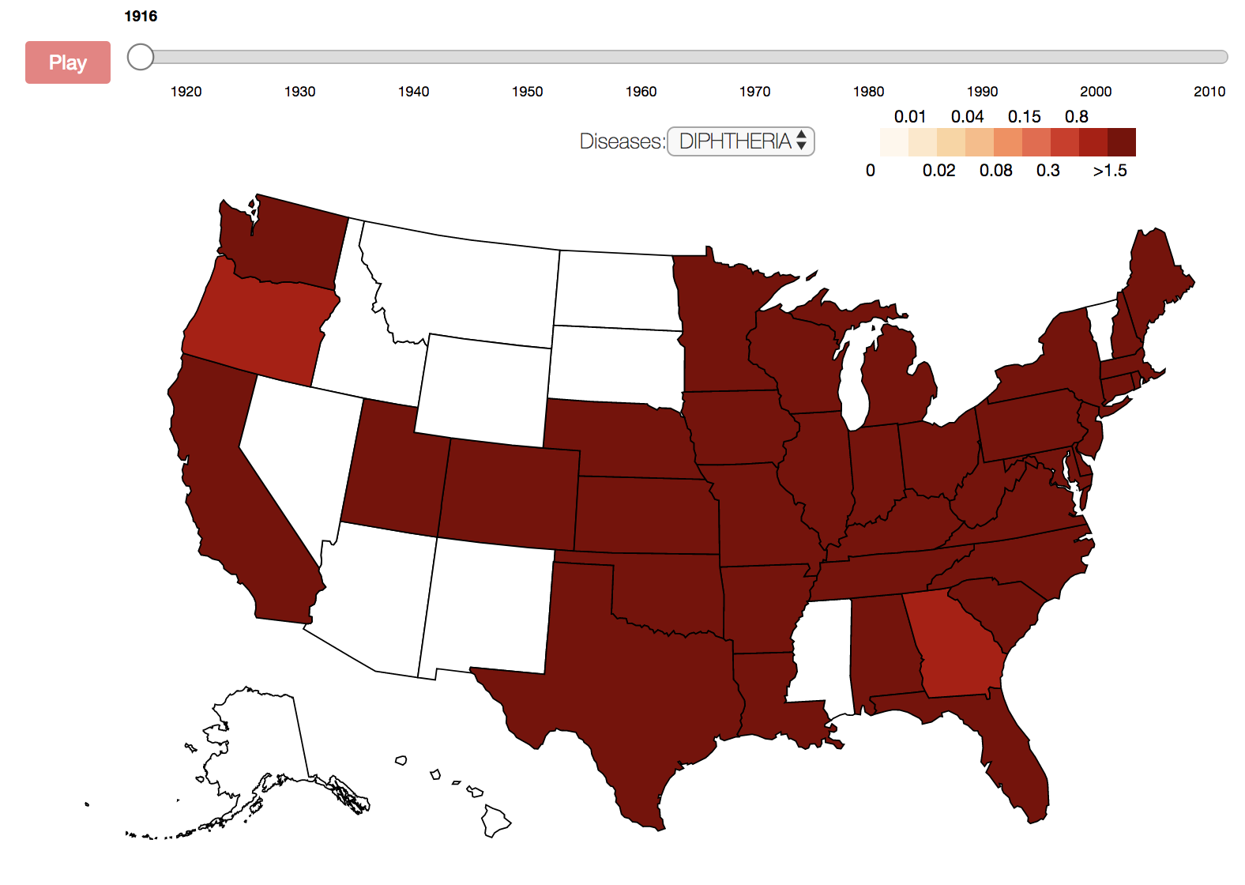
Spatial Patterns
An overview through map
Layout: map
Visual encoding:
X & Y: geo-spatial location
Color: incidence
Animation: time
Interaction:
Mouse over: detail information of each state in a year
Mouse over: on legend highlight states of that value

Slide 18
Discussion
Why use geographical map
Map can connect disease data and spatial information
Use map can compare rates between different states
Use map can explore the spatial influence
Patterns
Spatial location has some influence
E.g. diphtheria has a high rate at both east and west coast
Potential reasons: high population concentration
Potential factors
Weather
Population

Slide 19
Future Work
Try to link the visualizations in the same topic:
Link the scatterplot and the line chart so that the time slide and control both of them
Link the map and the small multiple line chart so that when select and highlight a state, the small line chart of the state could also be highlighted
Add narratives about brief history of the diseases:
Explosions in the history
Vaccine innovation and usage
Important historical events, i.e. World War II
Try the same thing using Level 2 data
Notes:
We hope that we can link the

Slide 20

Reference
Project Tycho: https://www.tycho.pitt.edu/.
GDP per capita: Bureau of Economic Analysis (https://bea.gov).
Matsubara, Yasuko, et al. "FUNNEL: automatic mining of spatially coevolving epidemics." Proceedings of the 20th ACM SIGKDD international conference on Knowledge discovery and data mining. ACM, 2014.
Van Panhuis, Willem G., et al. "Contagious diseases in the United States from 1888 to the present." The New England journal of medicine 369.22 (2013): 2152.

